Slide 1
Diabetes Prediction Using Machine Learning based SVM Classifier

Slide 2
ABSTRACT
Cyber-Physical Systems (CPS) embed computation and communication capability into its core to regulate physical processes and seamlessly mediate between the cyber and the physical world for various control and monitoring tasks.
Health CPS, acts as a health monitoring system to dynamically capture, process, and analyze health sensor data through integrated Internet Of Things (IoT)-enabled cyber-physical processes.
These systems can suitably support patients suffering from non-communicable diseases (NCDs) or who are at risk of suffering from those.
Identifying the risk of NCDs, such as heart disease and diabetes, requires artificial intelligence (AI) techniques into the core of health CPS.

Slide 3
ABSTRACT
Recently, there has been growing interest to incorporate machine learning into CPS, which can facilitate the disease classification, detection, monitoring, and prediction of several NCDs.
However, there is a shortage of visible work that focus on early-stage risk prediction of these diseases.
Hence, this paper proposes a novel machine learning based health CPS framework that addresses the challenge of effectively processing the wearable IoT sensor data for early risk prediction of diabetes as an example of NCDs.

Slide 4
OBJECTIVES
To predict the Non-Communicable Disease like Diabetes, in its earlier stage with temporal data modeling by utilizing a deep learning algorithm called Support Vector Machine (SVM).
To help the medical practitioners learn the major causes of a NCDs and avoid it before its actual occurrence in patient.
Comparing the results obtained from the proposed model with the existing model for its performances.

Slide 5
EXISTING SYSTEM
The recent system used a Data and Cloud-driven Framework model to predict, monitor, and control the risk of coronary heart disease in CPS context.
This system used ANFIS fuzzy inference system to identify the different levels of risk assessment.

Slide 6
INTRODUCTION
Cyber-physical systems (CPS) promote the integration of IoT-enabled physical world with the computation-powered cyber world through seamless communication between them.
The interconnection between cyber and physical world are usually assisted by a feedback-loop control system, which enables CPS to be more adaptive to the changes in the physical world.
The processing of diverse and dynamic data sources using different Machine Learning (ML) algorithms enable the CPS to exhibit higher intelligence which supports various application domains, including smart healthcare, transportation and others.

Slide 7
PROPOSED SYSTEM
The proposed system an ML-powered HCPS system for the prediction of diabetes.
Unlike traditional ML approach, which follows a longer training process associated with huge pre-processing, the proposed approach omits/ minimizes the pre-processing stage by introducing an epidemiological knowledge base.
This includes the use of a verified training dataset approved by medical practitioner and rules to extract health data from raw sensor's data.
For the testing phase, the proposal prescribes subsequent stages for obtaining a dynamic test dataset, which is produced from a combination of sensory and non-sensory data to fit the training data structure.

Slide 8
SYSTEM ARCHITECTURE
Pre processing
Normalization
Data Cleaning
Feature Visualization
Data collection
TRAINING PHASE
SVM Based Model Training
Prediction
TESTING PHASE
Pre processing
Data Cleaning
Normalization
Data Input

Slide 9
BLOCK DIAGRAM
Training Phase
Dataset
Preprocessing
Sort instance by Feature Importance
Test Data
Remove Duplicates
Missing Data Imputation
Normalization
SVM Classification
NCD risk Prediction

Slide 10
WORKING PRINCIPLE
The data for this study has been attained using data mining technique.
This data has been standardized, so as to be error free in nature and developed into a dataset.
Then analyze the dataset to define column parameters and data anomalies.
After data analysis, the values had been identified as missing, wrong type values or outliers and which columns were rejected as unconvertible for use with the model.
The algorithm used to train this system is, a machine learning technique called Support Vector Machine (SVM).

Slide 11
WORKING PRINCIPLE
After pre-processing, important attributes that leads to accurate prediction are extracted.
The final risk prediction of non-communicable disease is carried out with the help of SVM algorithm.

Slide 12
FLOWCHART
Start
Collect Patient Data
Identify Relevant Risk Factors
Calculate Risk Scores
Interpret Risk Score
Re-assess Risk
Stop

Slide 13
EXPLANATION
Collect Patient Data
Age
Gender
Family History of Disease
Lifestyle Factors (e.g., smoking, alcohol consumption, exercise, diet)
Medical History (e.g., chronic conditions, medications)
Anthropometric Measures (e.g., BMI, waist circumference, blood pressure)
Identify Relevant Risk Factors
Based on expert opinion, identify the risk factors most relevant to the Non-communicable disease.

Slide 14
EXPLANATION…
Calculate Risk Scores
Use established scoring systems or predictive models to calculate the patient's risk score based on their relevant risk factors.
Interpret Risk Score
Determine the patient's level of risk based on their score.
Provide appropriate recommendations for management based on the patient's risk level (e.g., lifestyle modifications, screening tests, medication).
Re-assess Risk
Re-evaluate the patient's risk periodically based on changes in their risk factors or disease status.

Slide 15
MODULES
Training Module
Testing Module
Data pre-processing
Data visualization
Data normalization
Feature Selection
Model training
Data pre-processing
Data visualization
Data normalization
Prediction

Slide 16
MODULE EXPLANATION
The Training Phase is used for train the data from dataset for carrying out the prediction which is needed.
It basically trains the algorithm to create the correct output.
The training set should be labeled correctly, so that the prediction would be more accurate.
80% of data from dataset is used for training.
This phase includes 3 stages namely pre-processing, data visualization, normalization and model training.
Data preprocessing such as removal of duplicate data, missing data imputation and normalization are performed.
Data visualization means a graphical representation of data which is an efficient way of communicating with numerous data in a dataset.
Data normalization structures the dataset and makes the outcome falls between 0 to 1.

Slide 17
MODULE EXPLANATION…
The important features for accurate prediction results are selected using the Modified Squirrel Search Algorithm.
The 8 features selected in this approach are as follows:
Number of times the person had been pregnant
Glucose level in blood
Diastolic blood pressure
BMI
Thickness of skinfold (mm)
Insulin level in a period of 2 hours
Pedigree Function (hereditary factor)
Age of the person

Slide 18
MODULE EXPLANATION…
These 8 attributes should be in numeric format, which is then loaded into the algorithm and are trained to make decisions whether one reads diabetes positive or negative.
To evaluate the performance of the model a set of observations is performed in testing phase by using some performance metric with the help of remaining 20% data from the dataset.
The observations taken from the training set are involved in the testing phase.
The model testing is also the same as that of the model training, which includes the pre-processing, data visualization, normalization, but at last prediction will be carried out.
The proposed system uses SVM Classifier for classifying the diabetes and non-diabetes sample.
The classification is based on the binary value 0 and 1.
If the binary value is 0 then diabetes is negative in and the binary value is 1 then diabetes is positive.

Slide 19
APPLICATIONS
Healthcare Sectors
Hospitals
Medical Laboratories

Slide 20
SOFTWARE USED
MATLAB

Slide 21
MATLAB is a programming language and software environment used for numerical computation, data analysis, visualization, and algorithm development.
It offers a wide range of tools and functions for tasks such as matrix manipulation, plotting, simulation, and machine learning. MATLAB is widely used in various fields, including mathematics, engineering, and scientific research.

Slide 22
RESULT AND DISCUSSION
The Decision Tree classifier for diabetes prediction using the Pima Indian Diabetes dataset was 81.67%.
It was outperformed by the ANN classifier with an accuracy of 82.85% for the same dataset, which is 1.18% higher than that of the decision tree classifier.
It was outperformed by the proposed SVM classifier by obtaining 84.79% which is of 1.85% higher than the accuracy of ANN classifier and 3.12% higher than the accuracy of Decision tree classifier for the same dataset.
Algorithm | Accuracy
SVM | 84.79%
ANN | 82.85%
Decision Tree | 81.67%

Slide 23
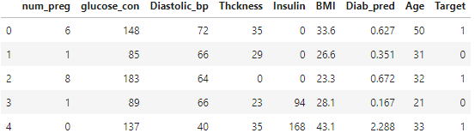
SCREENSHOTS
This is the head rows of dataset

Slide 24
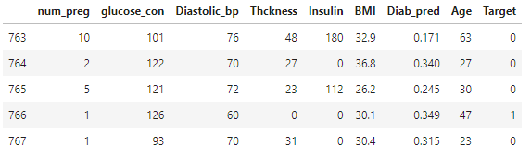
SCREENSHOTS…
This is the tail rows of dataset

Slide 25
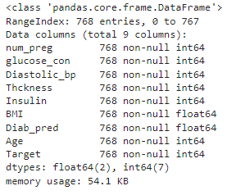
SCREENSHOTS…
This is the description of all the attributes in the dataset

Slide 26
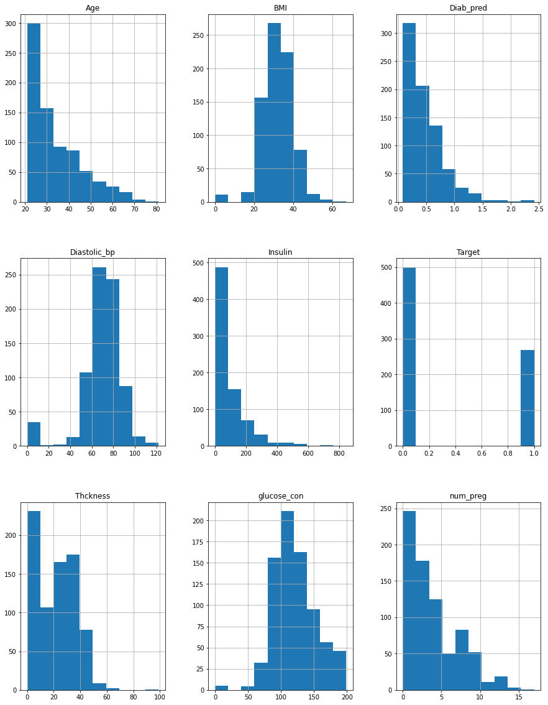
Screenshots…
This is the visualization of all the attributes in the dataset

Slide 27
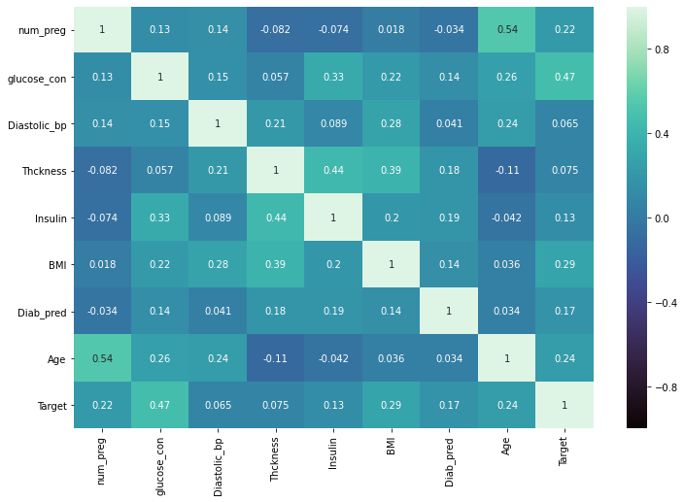
SCREENSHOTS…
This is the heatmap of each attribute in the dataset

Slide 28
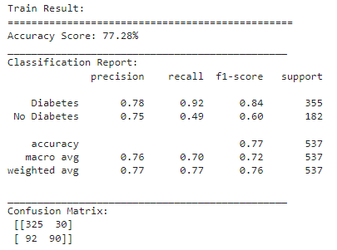
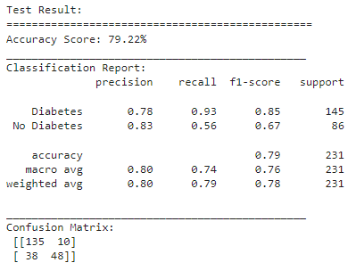
Screenshots…
This is the results obtained from training phase
This is the results obtained from testing phase

Slide 29
CONCLUSION AND FUTURE ENHANCEMENT
In this paper, we have used PIMA datasets for diabetes disease from the machine learning laboratory. All the patient’s data are trained by using SVM.
The choice of best value of parameters for particular kernel is critical for a given amount of data.
SVM approach can be successfully used to detect a common disease with simple clinical measurements, without laboratory tests.
In the proposed work, SVM with Squirrel Search is used for classification.
The performance parameters such as the classification accuracy, sensitivity, and specificity of the SVM have found to be high, thus making it a good option for the classification process.
In future the performance of SVM classifier can be improved by feature subset selection process.

Slide 30
REFERENCES
Alim, M.A., et al., “Robust heart disease prediction: a novel approach based on significant feature and ensemble learning model”. In 2020 3rd International Conference on Computing, Mathematics and Engineering Technologies (iCoMET). IEEE, (2020).
Somasundaram, T.J.P.K., “An empirical study on prediction of heart disease using classification data mining techniques”, presented at the IEEE-International Conference On Advances In Engineering, Science And Management (ICAESM -2012), (2015).
C.A. Cheng and H.W. Chiu, "An artificial neural network model for the evaluation of carotid artery stenting prognosis using a national-wide database", 2017 39th Annual International Conference of the IEEE Engineering in Medicine and Biology Society (EMBC)., Jul 2017.
R. Kannan and V. Vasanthi, "Machine learning algorithms with ROC curve for predicting and diagnosing the heart disease" in Soft Computing and Medical Bioinformatics., Springer Singapore, pp. 63-72, Jun 2018.
C. B. C. Latha and S. C. Jeeva, "Improving the accuracy of prediction of heart disease risk based on ensemble classification techniques", Informatics in Medicine Unlocked, vol. 16, pp. 100203, 2019.

Slide 31
REFERENCES…
S. Mohan, C. Thirumalai and G. Srivastava, "Effective heart disease prediction using hybrid machine learning techniques", IEEE Access, vol. 7, pp. 81542-81554, 2019.
J. Singh and R. Kaur, "Cardio vascular disease classification ensemble optimization using genetic algorithm and neural network", Indian Journal of Science and Technology, vol. 9, no. S1, Dec 2016.
S. Thaiparnit, S. Kritsanasung and N. Chumuang, "A classification for patients with heart disease based on hoeffding tree", 2019 16th International Joint Conference on Computer Science and Software Engineering (JCSSE), Jul 2019.
Ahmet Ilhan KaanUyar, “Diagnosis of heart disease using genetic algorithm based trained recurrent fuzzy neural networks”, 9th international conference on theory and application of soft computing, computing with words and perception, ICSCCW, Budapest, Hungary, 24-25 Aug 2017.
Amin, M.S., Chiam, Y.K., Varathan, K.D., “Identification of Significant features and data mining techniques in predicting heart disease”, Telematics Inf (2019), pp. 82-93.

Slide 32
Thank you

